Slide 1
Digestive Health
Jennifer Franco, CN, ACN

Slide 2
By the numbers
                1.7 L
                2 L
                11.5 L
                100 mL

Slide 3
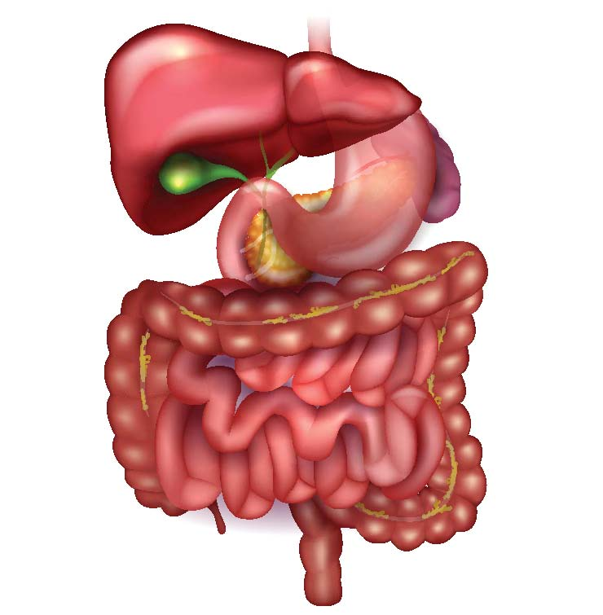
Digestive Tract
Mouth
Esophagus
Stomach
Small Intestine
Large Intestine
Colon

Slide 4
Ancillary Organs
Food does not actually pass through these organs, but they are absolutely necessary for proper digestion.
  Liver
  Gallbladder
  Pancreas

Slide 5
Digestive Tract
Mouth
Esophagus
Stomach
Small Intestine
Large Intestine
Colon

Slide 6
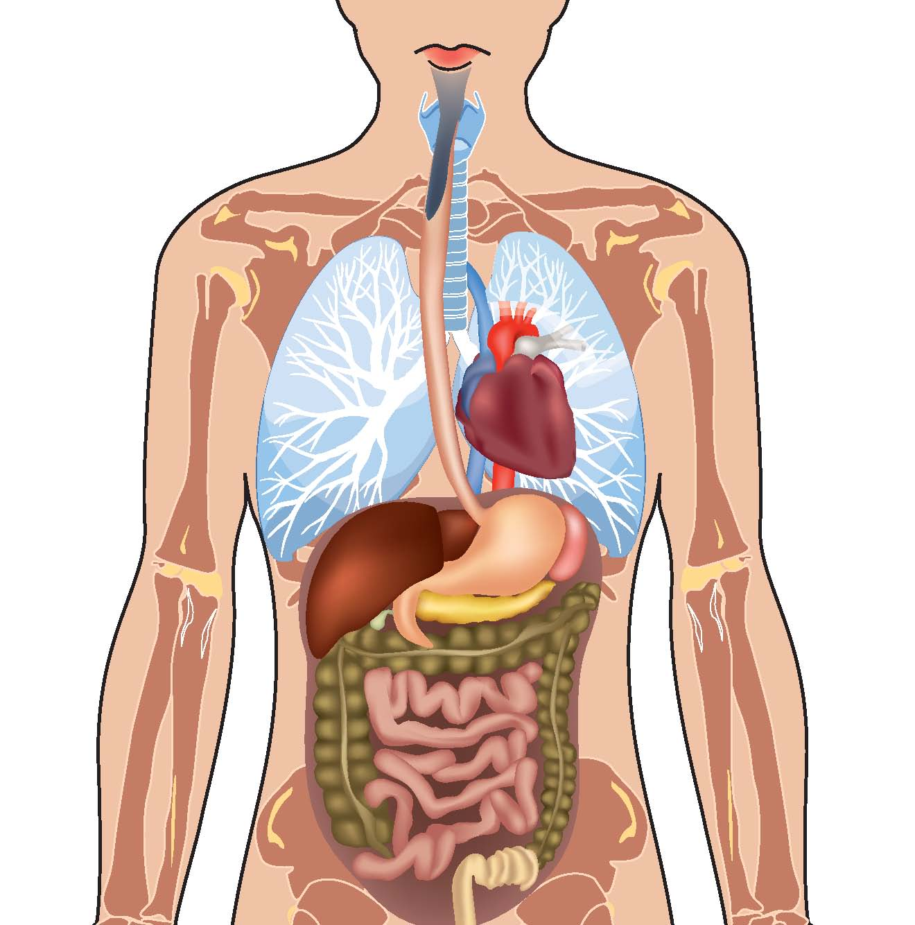
Functional Nutrition and Herbal Therapy
What are the body systems involved?
How can we support the tissues?

Slide 7
Foods and Herbs
Vitamin B
Zn, Mg, Fe, Se
Enzymes:
  Protease
  Lipase
  Amylase
  Lactase
Digestive Bitters
  Gentian
  Wormwood
  Feverfew
Licorice
Ginger
Chamomile

Slide 8
Food for thought
51 Million
CDC, 2010
Notes:
Number of visits (to physician offices, hospital outpatient and emergency departments) with diseases of the digestive system as the primary diagnosis: 51.0 million
https://www.cdc.gov/nchs/data/ahcd/combined_tables/AMC_2009-2010_combined_web_table01.pdf

