Slide 1
Back to School: Immune Support
Jennifer Franco, CN, ACN

Slide 2
By the numbers
15 grams
20-30 grams
5 grams
Notes:
At birth, thymus is about 15 grams
Puberty – between 20-30 grams
At the age of 75-80 it’s only about 5 grams!

Slide 3
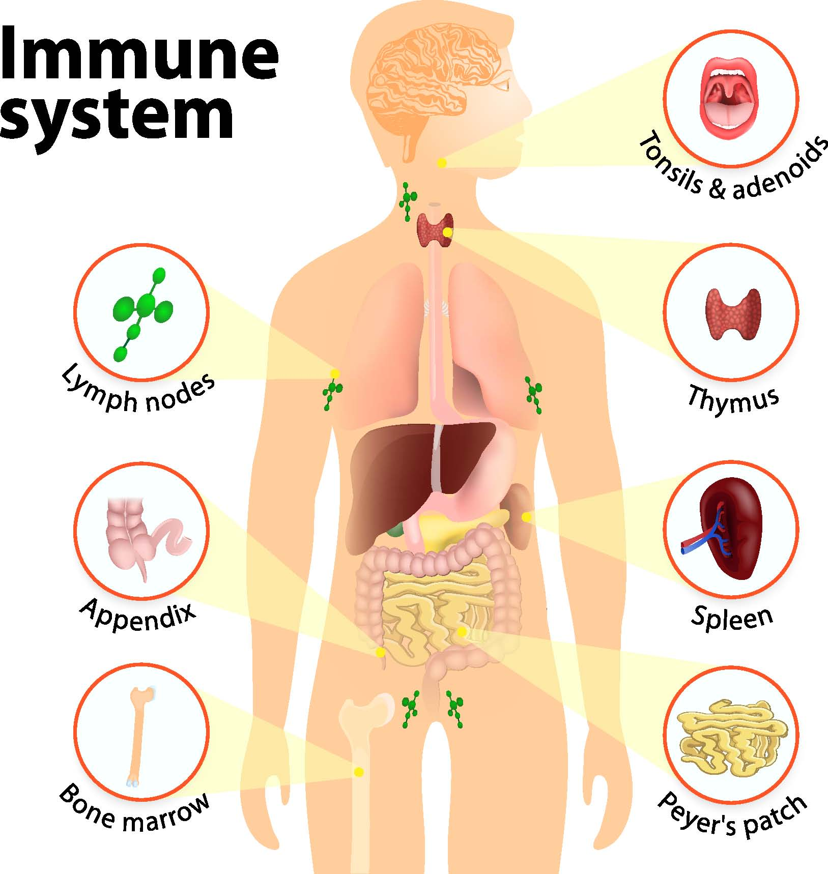
Immune System
Lymph nodes
Thymus
Spleen
Appendix
Bone
Gut

Slide 4
Symptoms of Immune Compromise
Asthma/Allergies
Bladder Infections
Broken Bones
Canker Sores
Chicken Pox
Cold/Flu
Coughing
Croup
Diaper Rash
Diarrhea
Ear ache
Eczema
Fevers
Food Poisoning
Hay Fever
Hives
Infections
Sneezing Attacks
Staph Infection
Strep Throat
Sun Burns
Teething
Virus
Vomiting
Warts
Wounds

Slide 5
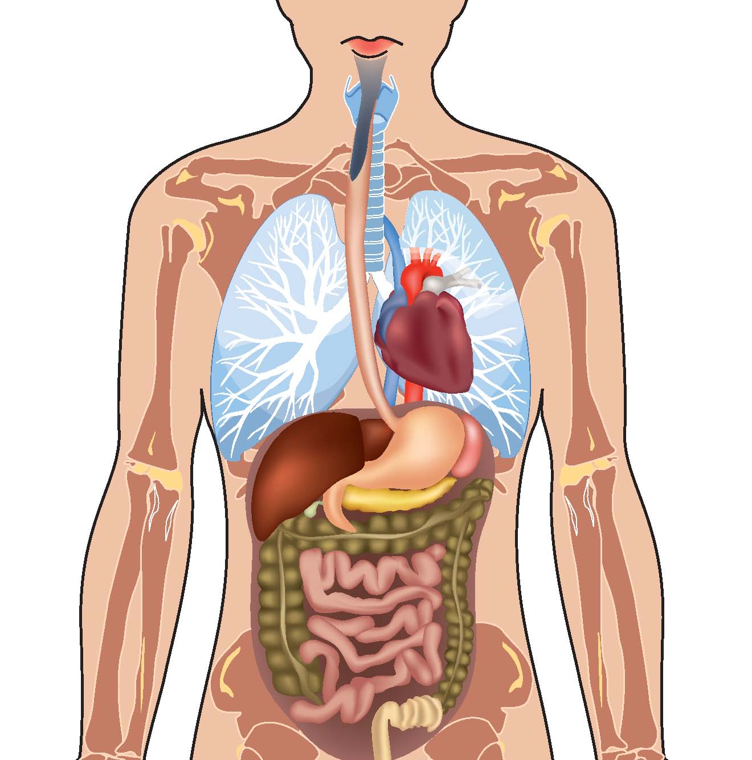
Functional Nutrition and Herbal Therapy
What are the body systems involved?
How can we support the tissues?

Slide 6
Foods and Herbs
Vitamin A
Vitamin D
Vitamin C
Calcium
Zinc
Bone Broth
Thymus Gland Extract
Echinacea
Andrographis
Holy Basil
Ginger

Slide 7
Food for thought
11.4 million
84%
Notes:
11.4 million unnecessary antibiotic prescriptions written to children and teens each year in the United States – Seattle Children’s Hospital, 2011
Antibiotics can also cause diarrhea or clostridium difficile colitis (C. diff), and early childhood exposure has even been associated with the development of asthma and Crohn’s disease.- Seattle Children’s Hospital, 2011
Antibiotics in children leads to an 84% risk increase of IBD - Pediatrics: Journal of the American Academy of Pediatrics “Antibiotic Exposure and IBD Development Among Children: A Population-Based Cohort Study” 2012

