Slide 1
Understanding Blood Sugar
Jennifer Franco, CN, ACN

Slide 2
By the numbers
150-170 lbs./year
150 grams/day
5 grams
Notes:
The bloodstream can only handle 5 grams of glucose at a time (a teaspoon)
How much our blood sugar (glucose levels) go up or down depends on how many carbs we eat in a meal

Slide 3
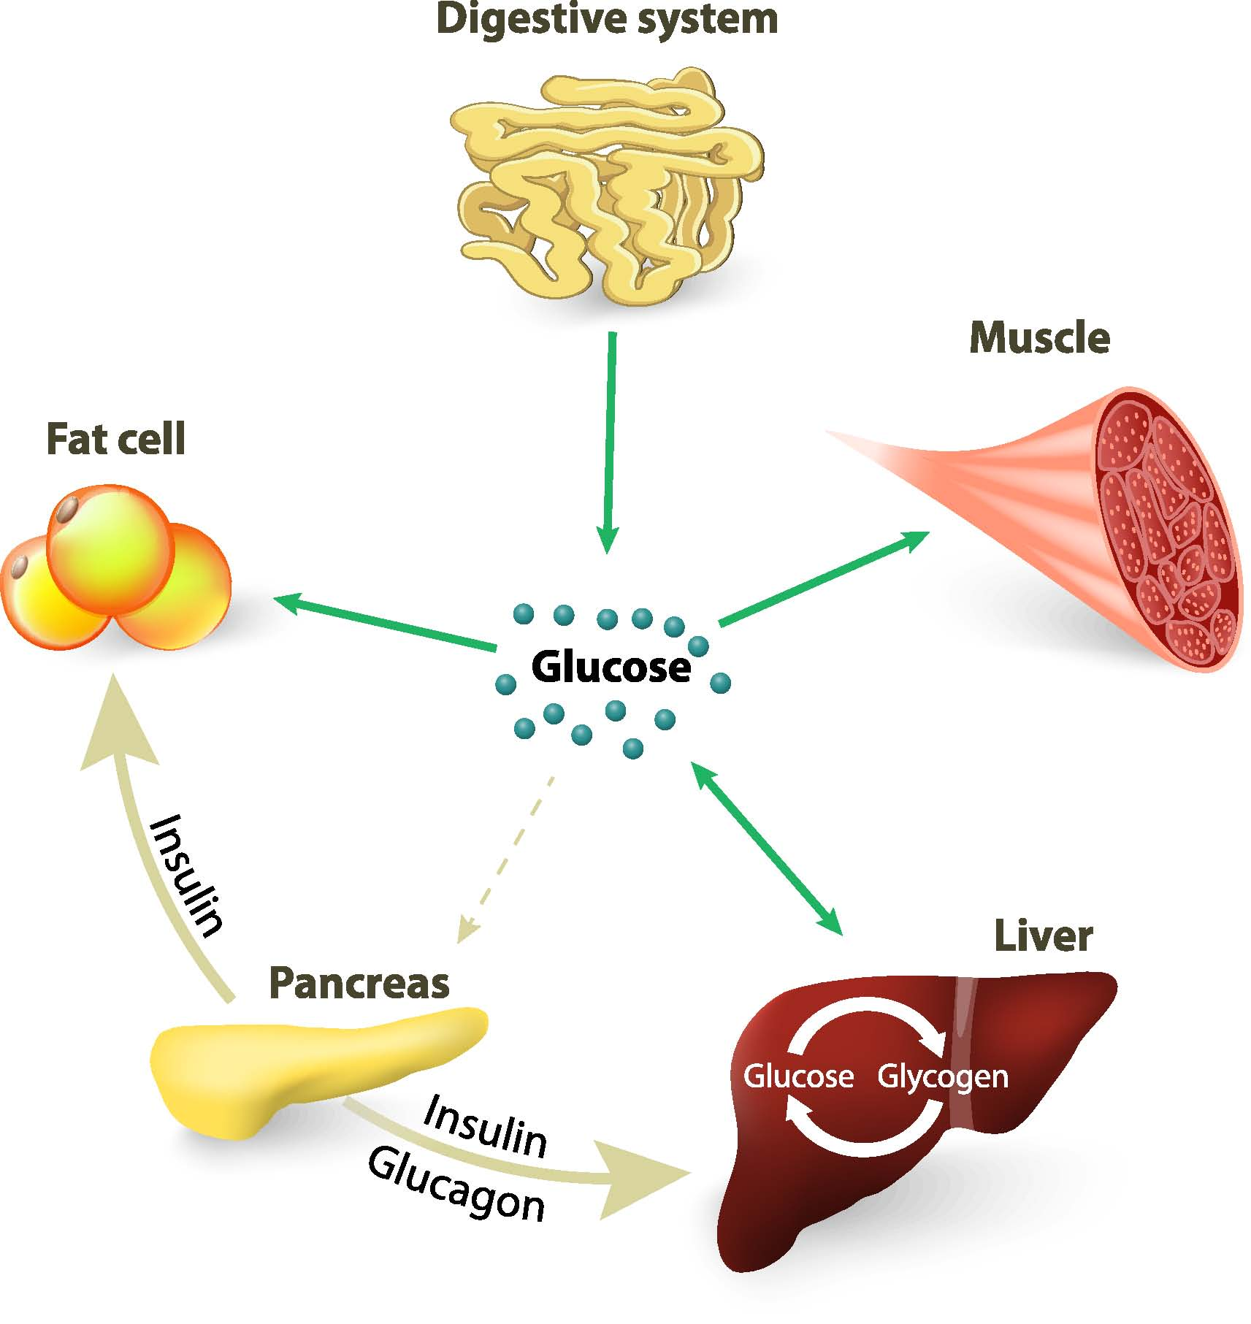
Blood Sugar
Digestion
Carbs → Glucose
Pancreas → Insulin
Distribution

Slide 4
Blood Sugar Dysregulation
Overconsumption of carbohydrates
Processed, refined carbohydrates
Fruits and vegetables
Over time, the Pancreas/Insulin becomes less effective
Abundance of glucose in the blood → inflammation
Metabolic Syndrome, Diabetes, Neuropathies, etc.

Slide 5
Blood Sugar
Digestion
Carbs → Glucose
Pancreas → Insulin
High glucose/insulin levels in the blood
Inflammation
X
X

Slide 6
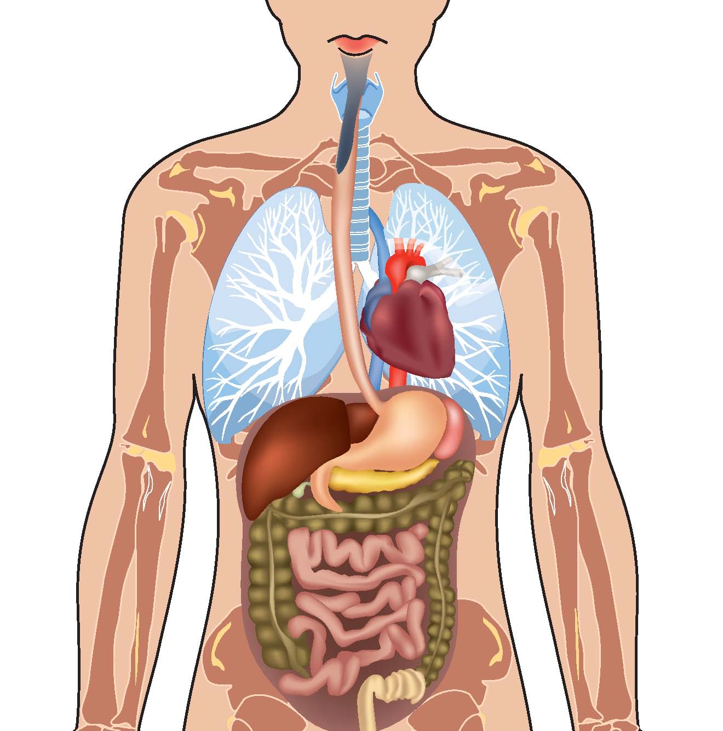
Functional Nutrition and Herbal Therapy
What are the body systems involved?
How can we support the tissues?

Slide 7
Foods and Herbs
Blood Sugar Stabilization =
Fat
+
Protein
+
Vegetables
HCl + Enzymes
Vitamin B
Zinc
Gymnema
Coleus Forte
Gotu Kola
Bilberry

Slide 8
Food for thought
Diabetes
Obesity
Heart Disease
Stroke
HBP
Liver Diseases
Arthritis
Alzheimer's Disease
Infertility
Cancers
Notes:
Diseases linked to high blood sugar, diabetes, weight gain/obesity, etc…

Slide 9
Functional Nutrition Assessment
3 Steps
Paperwork
Assessment
Report of Findings
Month to Month
No Contract
Month One: $195
3 Visits
SPECIAL: $100 OFF

Slide 10
Food for thought
29.1 million
21 million
CDC, 2012
Notes:
29.1 million people or 9.3% of the U.S. population have diabetes.
Diagnosed
21.0 million people
Undiagnosed
8.1 million people
(27.8% of people with diabetes are undiagnosed).
CDC, 2012
Deaths among people with diabetes, United States, 2010
Diabetes was the seventh leading cause of death in the United States in 2010 based on the 69,071 death certificates in which diabetes was listed as the underlying cause of death. In 2010, diabetes was mentioned as a cause of death in a total of 234,051 certificates.
Diabetes may be underreported as a cause of death. Studies have found that only about 35% to 40% of people with diabetes who died had diabetes listed anywhere on the death certificate and about 10% to 15% had it listed as the underlying cause of death.
In 2003–2006, after adjusting for population age differences, rates of death from all causes were about 1.5 times higher among adults aged 18 years or older with diagnosed diabetes than among adults without diagnosed diabetes.
total (Direct and indirect)
$ 245 billion
Direct medical costs
$ 176 billion
After adjusting for population age and sex differences, average medical expenditures among people with diagnosed diabetes were 2.3 times higher than people without diabetes.
indirect costs
$ 69 billion
(disability, work loss, premature death).

