Slide 1
Understanding Asthma
Jennifer Franco, CN, ACN

Slide 2
By the numbers
1,000,000,000
300,000,000
300,000,000
– 400,000,000
Notes:
Asthma and Allergies fall under the Chronic Respiratory Disease category.
More than a billion people across the world deal with Chronic Respiratory Disease. The World Health Organization (WHO) estimates approx. 300 million of these people suffer from asthma and another 300-400 million of these people suffer from allergies.
That means hundred of millions of people worldwide are affected by asthma and allergies, what is going on here? We’re going to start with asthma first and then move into allergies.
http://www.aaaai.org/about-aaaai/newsroom/asthma-statistics

Slide 3
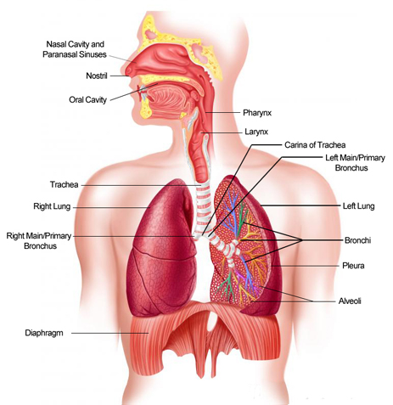
Respiration
Nose/Mouth
Pharynx
Trachea
Bronchi
Lungs
Diaphragm
Notes:
First, let’s discuss how respiration works in the human body. What is supposed to happen when we breath?
Air travels in through the nose/mouth, down the pharynx, into the trachea, passing through the bronchi and ultimately ending up in the lungs.
If you exercise hard, it may cause some muscle tightening and inflammation due to the increases stress or requirement of oxygen by the body. After the exercise, the inflamed tissues return to normal and breathing because easy again.

Slide 4
Asthma
Asthma occurs when the bronchial tubes become inflamed and narrowed which then limits the availability of air.
Chronic inflammation of the bronchial tubes can also affect the muscles that surround the airways which can tightened when stressed.
When air is limited to the body, this causes all the symptoms of asthma, such as: chest tightness, wheezing, coughing and shortness of breath.
Notes:
If you have asthma, your airways are always inflamed and become narrowed.
Let’s look at the picture again…

Slide 5
Asthma
Triggered inflammation
Bronchial constriction
Asthma flare-ups or attacks
Notes:
Now, let’s discuss what happens physiologically with Asthma.
It starts with a trigger such as a cold, pollution, pollen, exercise, etc. Air travels in through the nose/mouth, down the pharynx, into the trachea, but the trigger (let’s say pollution) starts the inflammatory response which constricts the bronchi and keeps air from getting into the lungs. This is when people feel the symptoms of chest tightening, wheezing, and get the attacks.

Slide 6
Diagnosis and Medical Intervention
If asthma is suspected, an allergist will recommend breathing tests to determine lung capacity.
If an allergy is suspected, the allergist may also recommend allergy testing.
To manage symptoms, it is recommended to take pharmaceuticals and avoid any triggers than can induce an attack.
Notes:
If asthma is suspected, you go to an allergist where they will do test to determine the capacity of the lungs.
Conventional medicine says that there is no cure for asthma. Instead, they focus on managing symptoms.

Slide 7
Pharmaceutical Drugs
Corticosteroids
Bronchodilators (LABA’s)
Leukotriene Antagonists
Rescue inhalers (SABA’s)

Slide 8
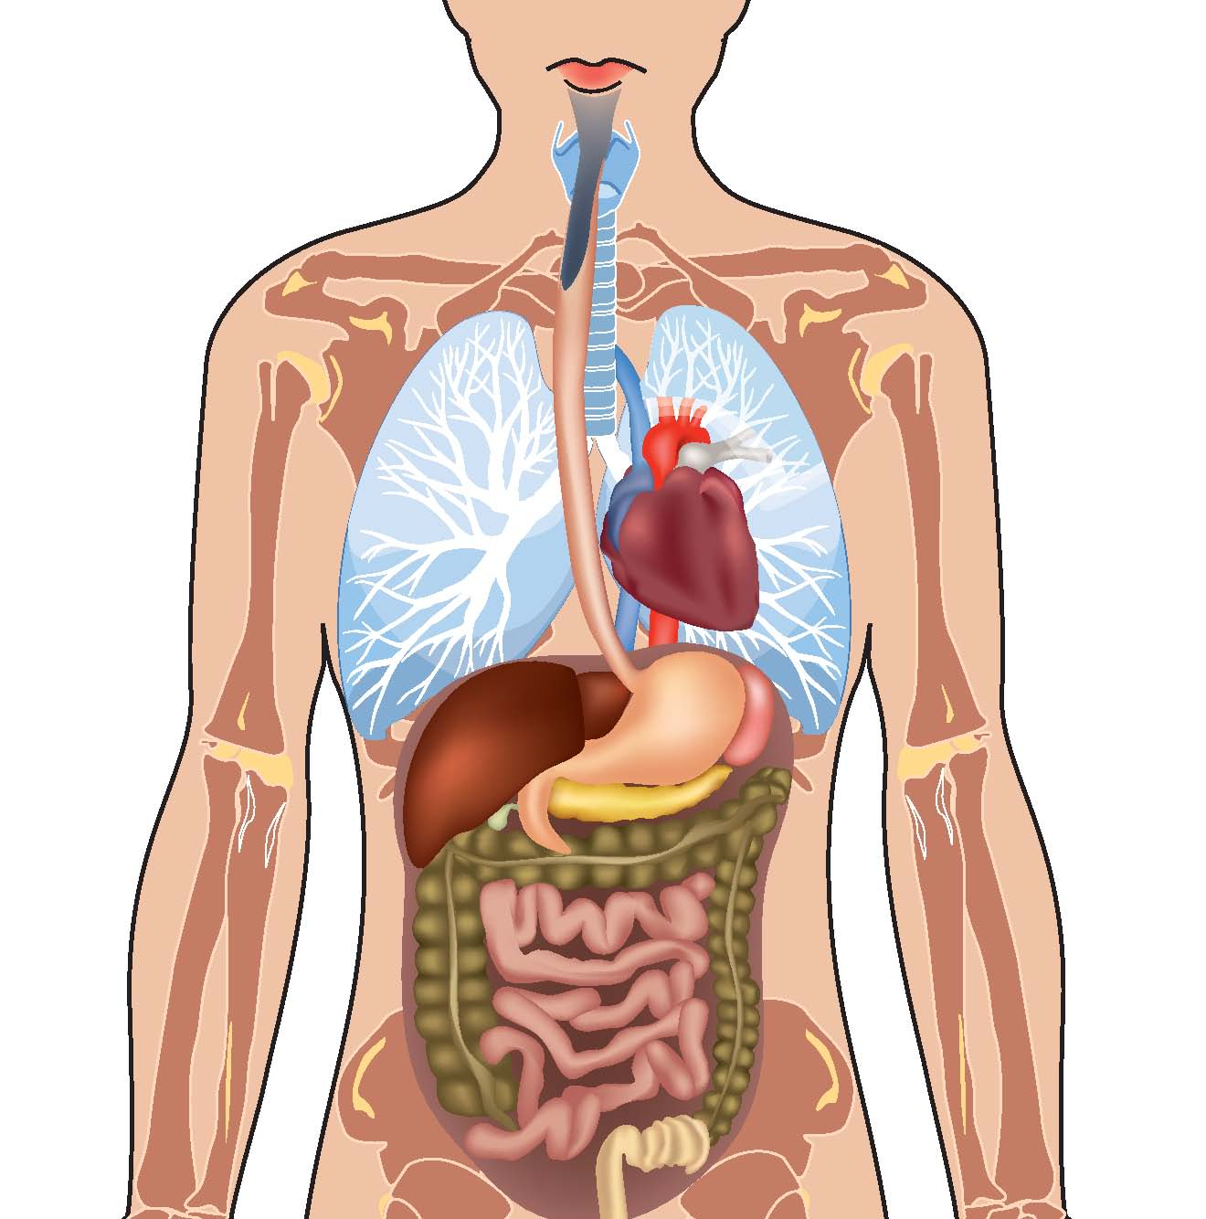
Functional Nutrition and Herbal Therapy
What are the body systems involved?
How can we support the tissues?
Notes:
Now, let’s discuss what happens physiologically with Asthma.
It starts with a trigger such as a cold, pollution, pollen, exercise, etc. Air travels in through the nose/mouth, down the pharynx, into the trachea, but the trigger (let’s say pollution) starts the inflammatory response which constricts the bronchi and keeps air from getting into the lungs. This is when people feel the symptoms of chest tightening, wheezing, and get the attacks.

Slide 9
Foods and Herbs
Bioflavonoids – microcirculation (anti-inflammatory)
Vitamin C (feed adrenals)
Copper (feed adrenals)
Lung PMG
Gingko
Turmeric, Boswellia (anti-inflammatory)
Albizia (support healthy nasal and bronchial passages)
Ginger (circulation – cough)
Notes:
What are the foods and herbs that support healthy breathing?

Slide 10
Functional Nutrition Assessment
3 Steps
Paperwork
Assessment
Report of Findings
Month to Month
No Contract
Month One: $195
3 Visits
SPECIAL: $100 OFF

Slide 11
Food for thought
$3,300
CDC, 2011
250,000
WHO, 2007
Notes:
Asthma cost the US about $3,300 per person with asthma each year from 2002 to 2007 in medical expenses, missed school and work days, and early deaths.
More than half (59%) of children and one-third (33%) of adults who had an asthma attack missed school or work because of asthma in 2008. On average, in 2008 children missed 4 days of school and adults missed 5 days of work because of asthma.
-Centers for Disease Control and Prevention, Vital Signs, May 2011.
Approximately 250,000 people die prematurely each year from asthma. Almost all of these deaths are avoidable.
- World Health Organization. Global surveillance, prevention and control of chronic respiratory diseases: a comprehensive approach, 2007.
What’s the real cost of asthma? The longer you have asthma, the more inflamed and damaged the surrounding tissue will become. It starts with limiting exercise, then walking and then patients tell me that they avoid laughing because they don’t want to trigger an asthma attack. What will it take for you or your family?

